Slide 1
2 Angels for Charlie

Slide 2
Recap
Rule based approach
Based on that reinforcement learning

Slide 3
Testing
Benchmark for each agent
Baseline is DefaultAgent
20 games (with 3 matches) per agent
First healthcheck, then testing itself

Slide 4
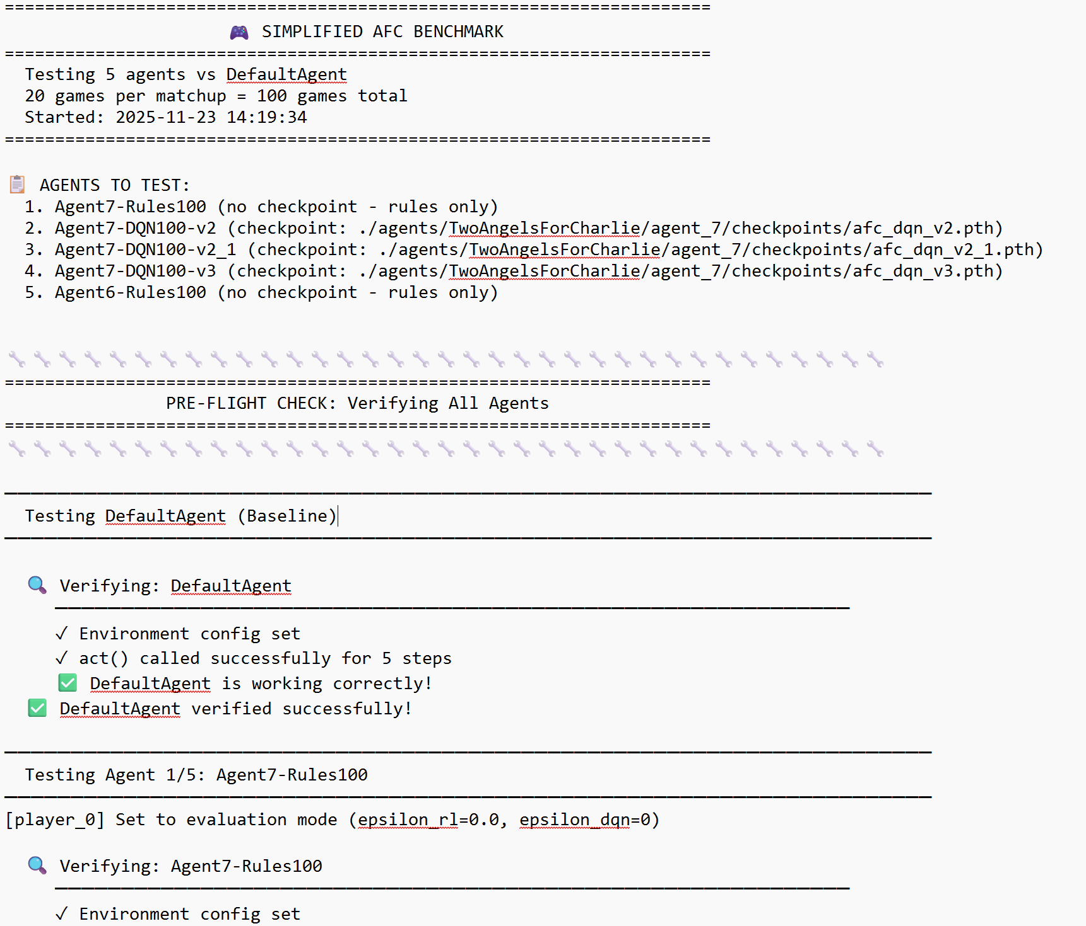
Logging
- Testing
Agents
Notes:
TL;DR: Ranged AoE attack that drains enemy energy in a square pattern. Your code finds best target tile by counting nearby opponents.
Wiederholen

Slide 5
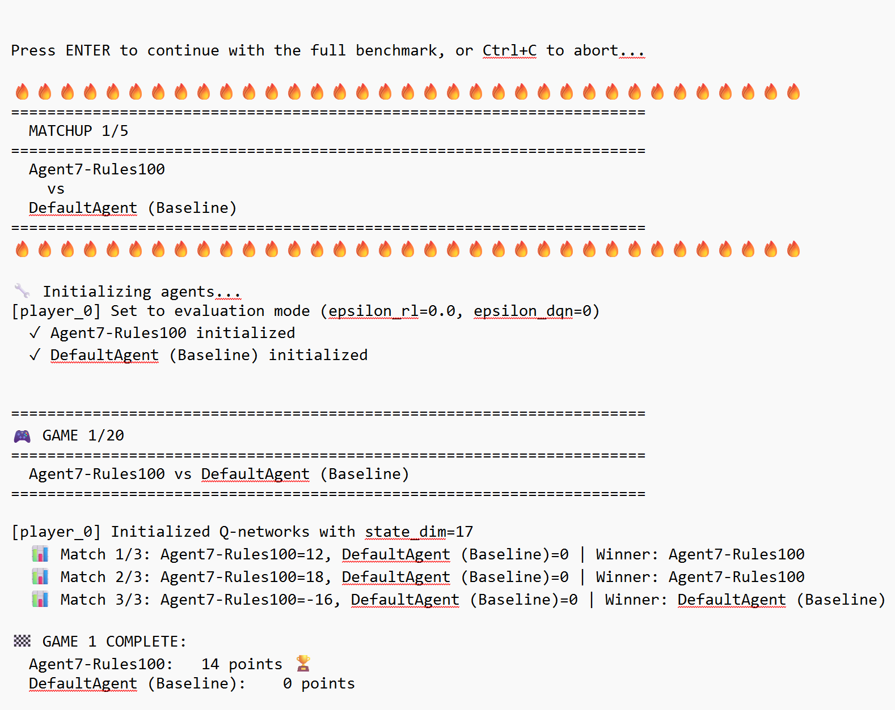
Logging
- Testing
Agents
Notes:
TL;DR: Ranged AoE attack that drains enemy energy in a square pattern. Your code finds best target tile by counting nearby opponents.
Wiederholen

Slide 6
Checkpoints
afc_dqn_selfplay.pth (training - 60 games against itself)
afc_dqn_v2.pth (training - 100 games with 20% and 79 games with 80% )
afc_dqn_v2_1.pth (training - 100 games with 20% and 44 games with 80% )
afc_dqn_v3.pth (training - 100 games with 20% and 132 games with 80% )
afc_dqn_v3_1.pth (training - 100 games with 20% and 99 games with 80% )
afc_dqn_v4.pth (training - 200 games with 20%)

Slide 7
Ranking
Rank Agent Games Wins Win% Avg Pts
──────────────────────────────────────────────────────────
🥇 1 Agent5-DQN100-v2_1 20 19 95.0% 66.8
🥈 2 Agent5-DQN100-v2 20 19 95.0% 66.5
🥉 3 Agent6-Rules100 20 19 95.0% 50.6
4 Agent5-DQN100-v3_1 20 18 90.0% 70.6
5 Agent5-Rules100 20 17 85.0% 71.2
6 DefaultAgent (Baseline) 100
──────────────────────────────────────────────────────────

Slide 8
with v_3_1 testing best DQN/Rules ratio:
Rank Agent Mix Games Wins Win% Avg Pts
──────────────────────────────────────────────────────────────
🥇 1 Agent5-DQN20-Rules80 20/80 20 19 95.0% 64.2
🥈 2 Agent5-DQN80-Rules20 80/20 20 18 90.0% 75.2
🥉 3 Agent5-DQN50-Rules50 50/50 20 18 90.0% 67.4
4 Agent5-DQN100-Rules0 100/0 20 17 85.0% 60.5
5 DefaultAgent (Baseline) Baseline
──────────────────────────────────────────────────────────────

Slide 9
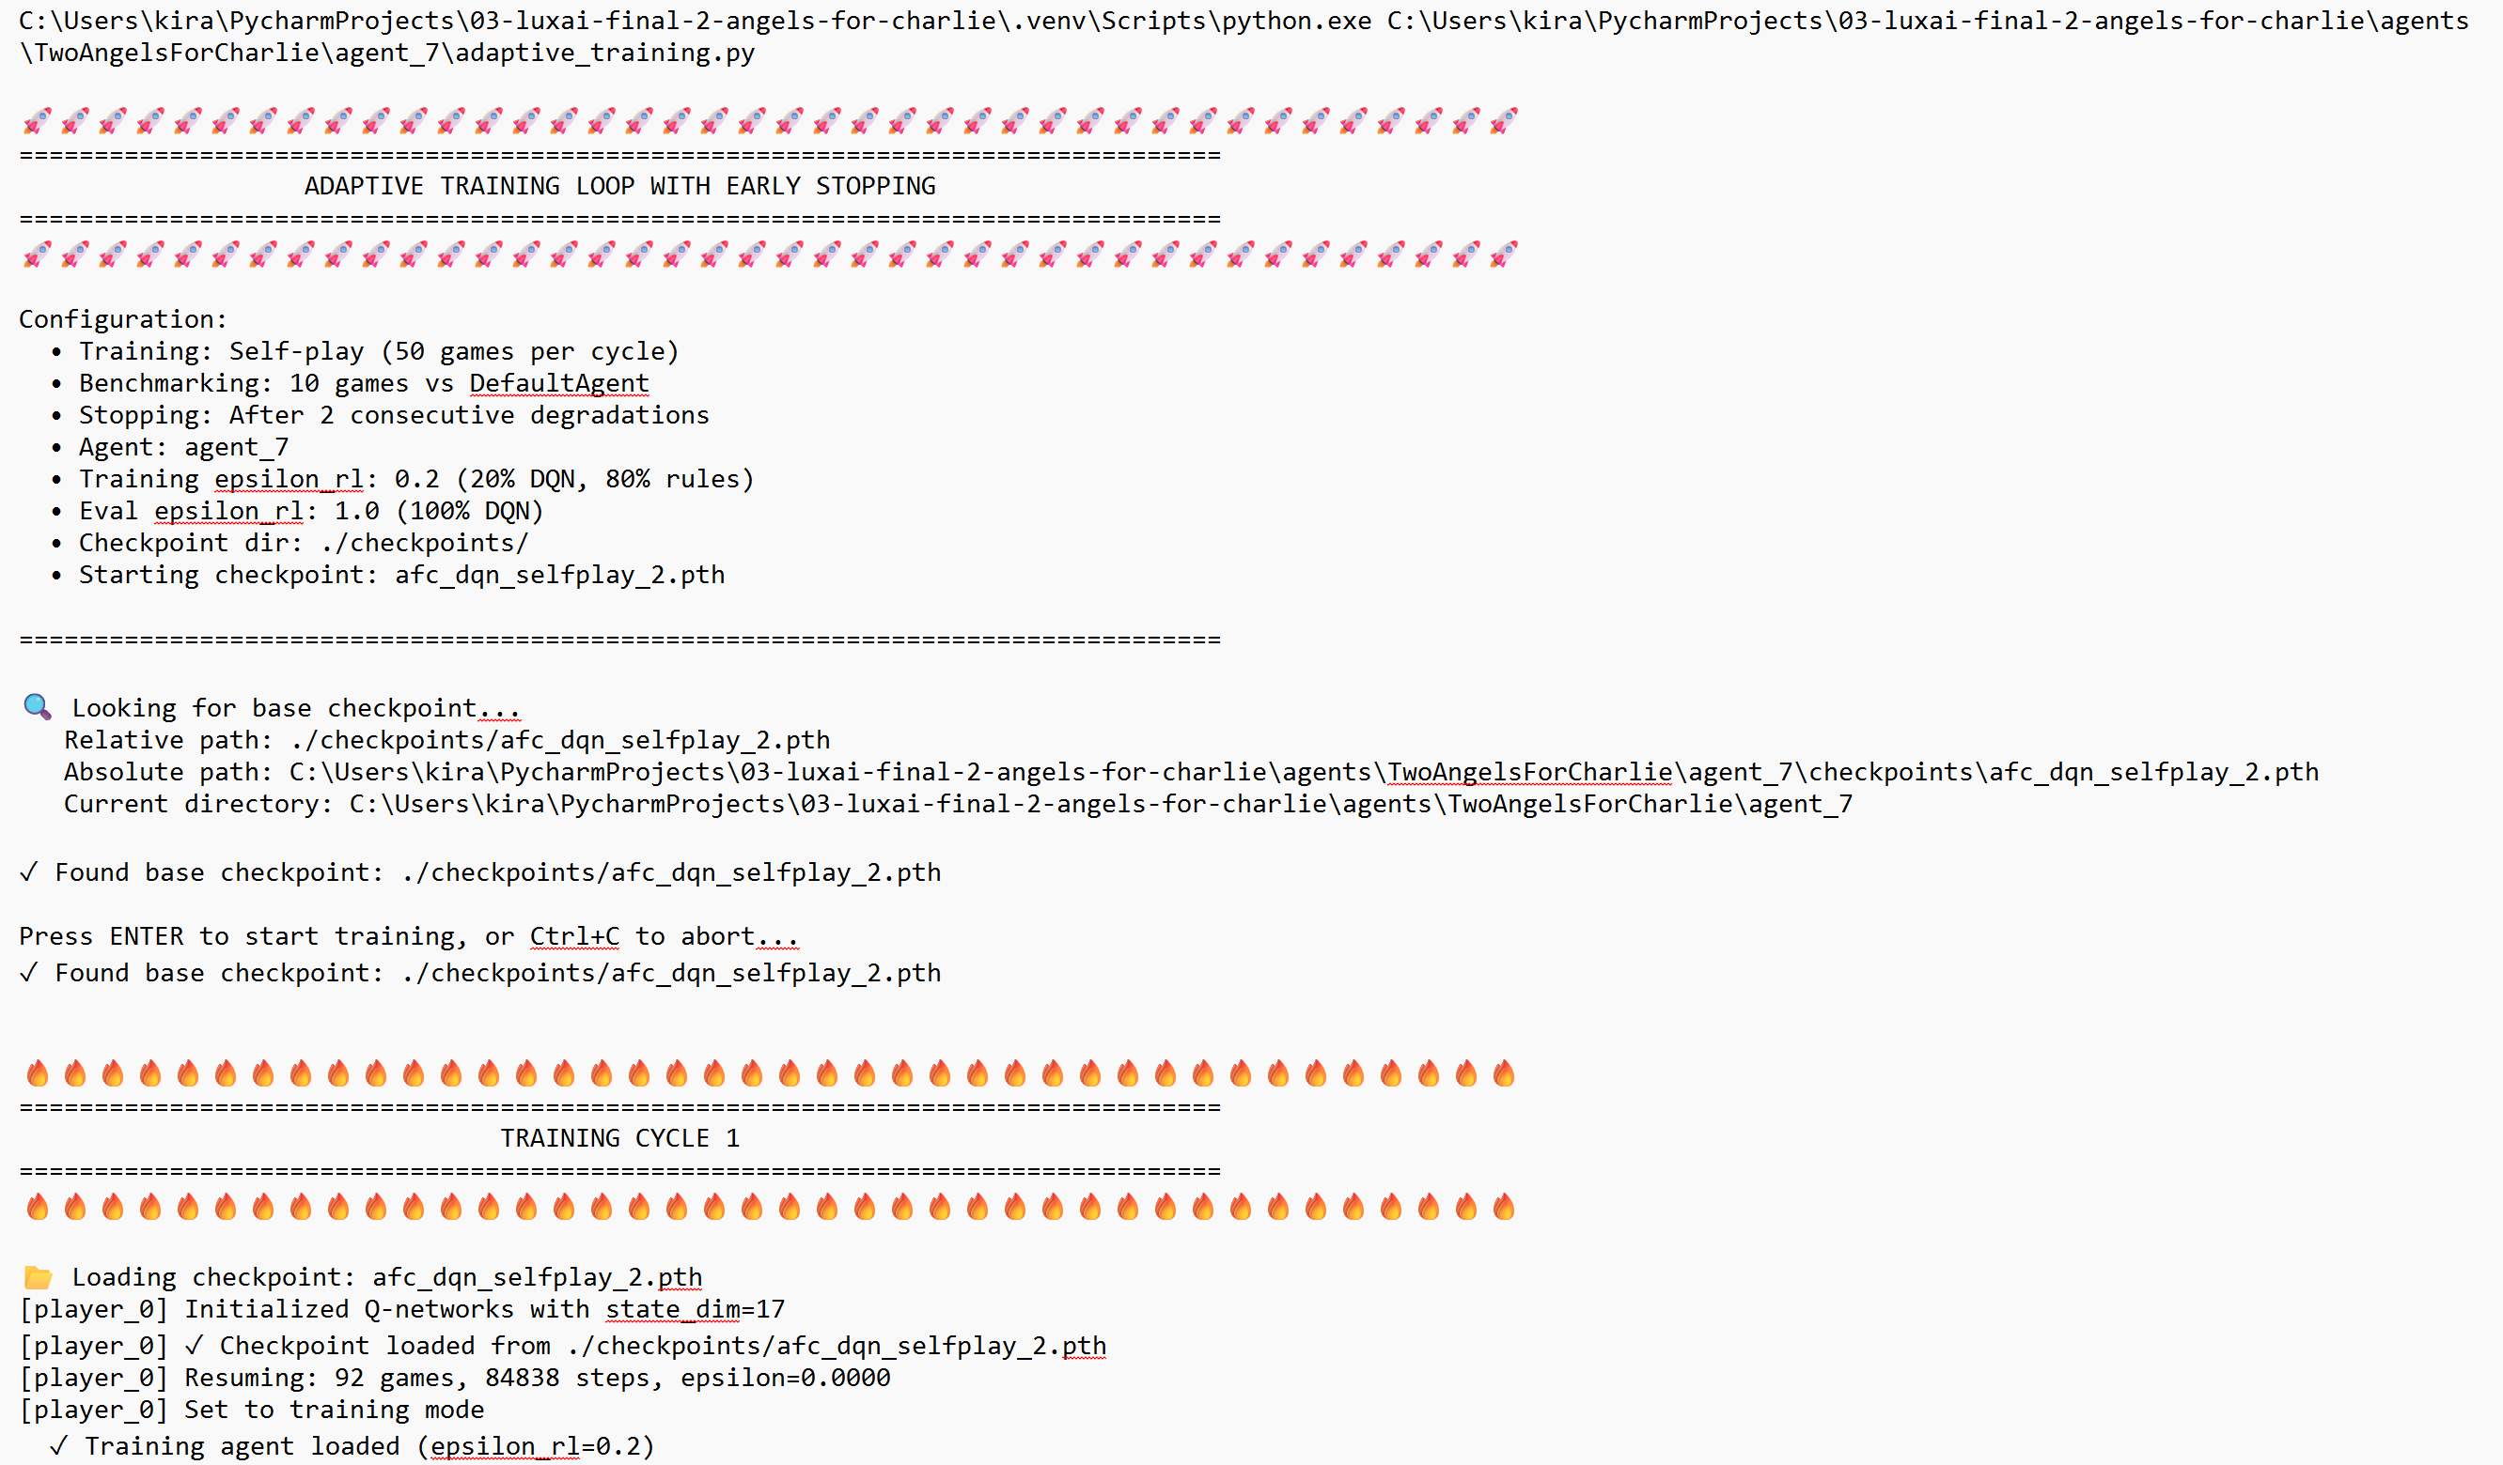
Adaptive training
Automated training (50 games) and testing (10 games performance evaluation)
Ranking checkpoints
Preventing overtraining

Slide 10
→ Didn‘t work as expected
Learnings:
- early testing strategy
- more planning and less experimenting
- need of better documentation

